Slide 1
Events
Notes:
Purpose: To introduce handling of simple mouse and keyboard input.
Learning Objective
By the end of this tutorial, children should be able to:
• Understand that programs can respond to input from various events, including from mouse buttons and keyboard keys.
• Understand that events can happen multiple times within one program.
• Understand that different events can run within the same program.
• Write simple programs that respond to mouse and keyboard events.

Slide 2
Event
Input
Output
Notes:
Introduce students to key vocabulary for this lesson:
Event (see next slide) Input is data sent to a computer system from devices such as a keyboard, mouse, microphone, camera or physical sensor. Input devices enable information from the outside world to get into a computer – without them, we wouldn’t even be able to switch the computer on! Some are built in; others are plugged in or wirelessly connected.
Output is data or information communicated from a computer system to the outside world via various devices.

Slide 3
In computing, an event is an action or occurrence recognised by software,
Notes:
In computing, an event is an action or occurrence recognised by software,

Slide 4
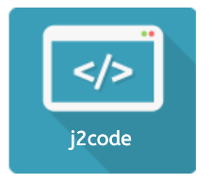
Notes:
Purpose: To introduce the use of loops in j2e code visual
Learning Objective - By the end of this tutorial children should be able to:
Understand that loops can be used to repeat sections of a program.
Create programs with simple loops.

Slide 5
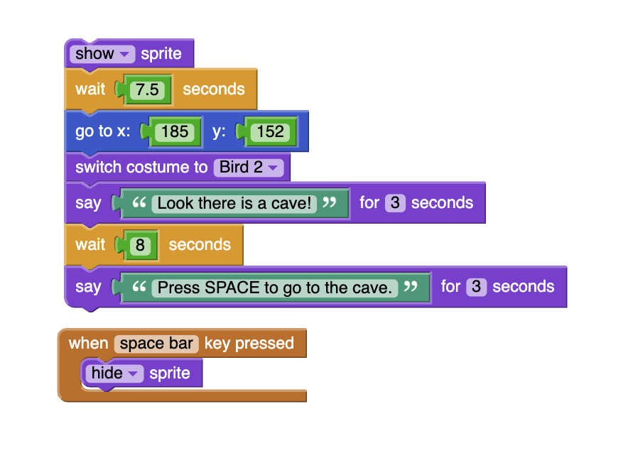
Notes:
Ask your students to trace this code (read through it). What can they see? Can they make a prediction about what this code will do?
Are there any coding block they recognise from previous lessons/are they any new blocks?

Slide 6
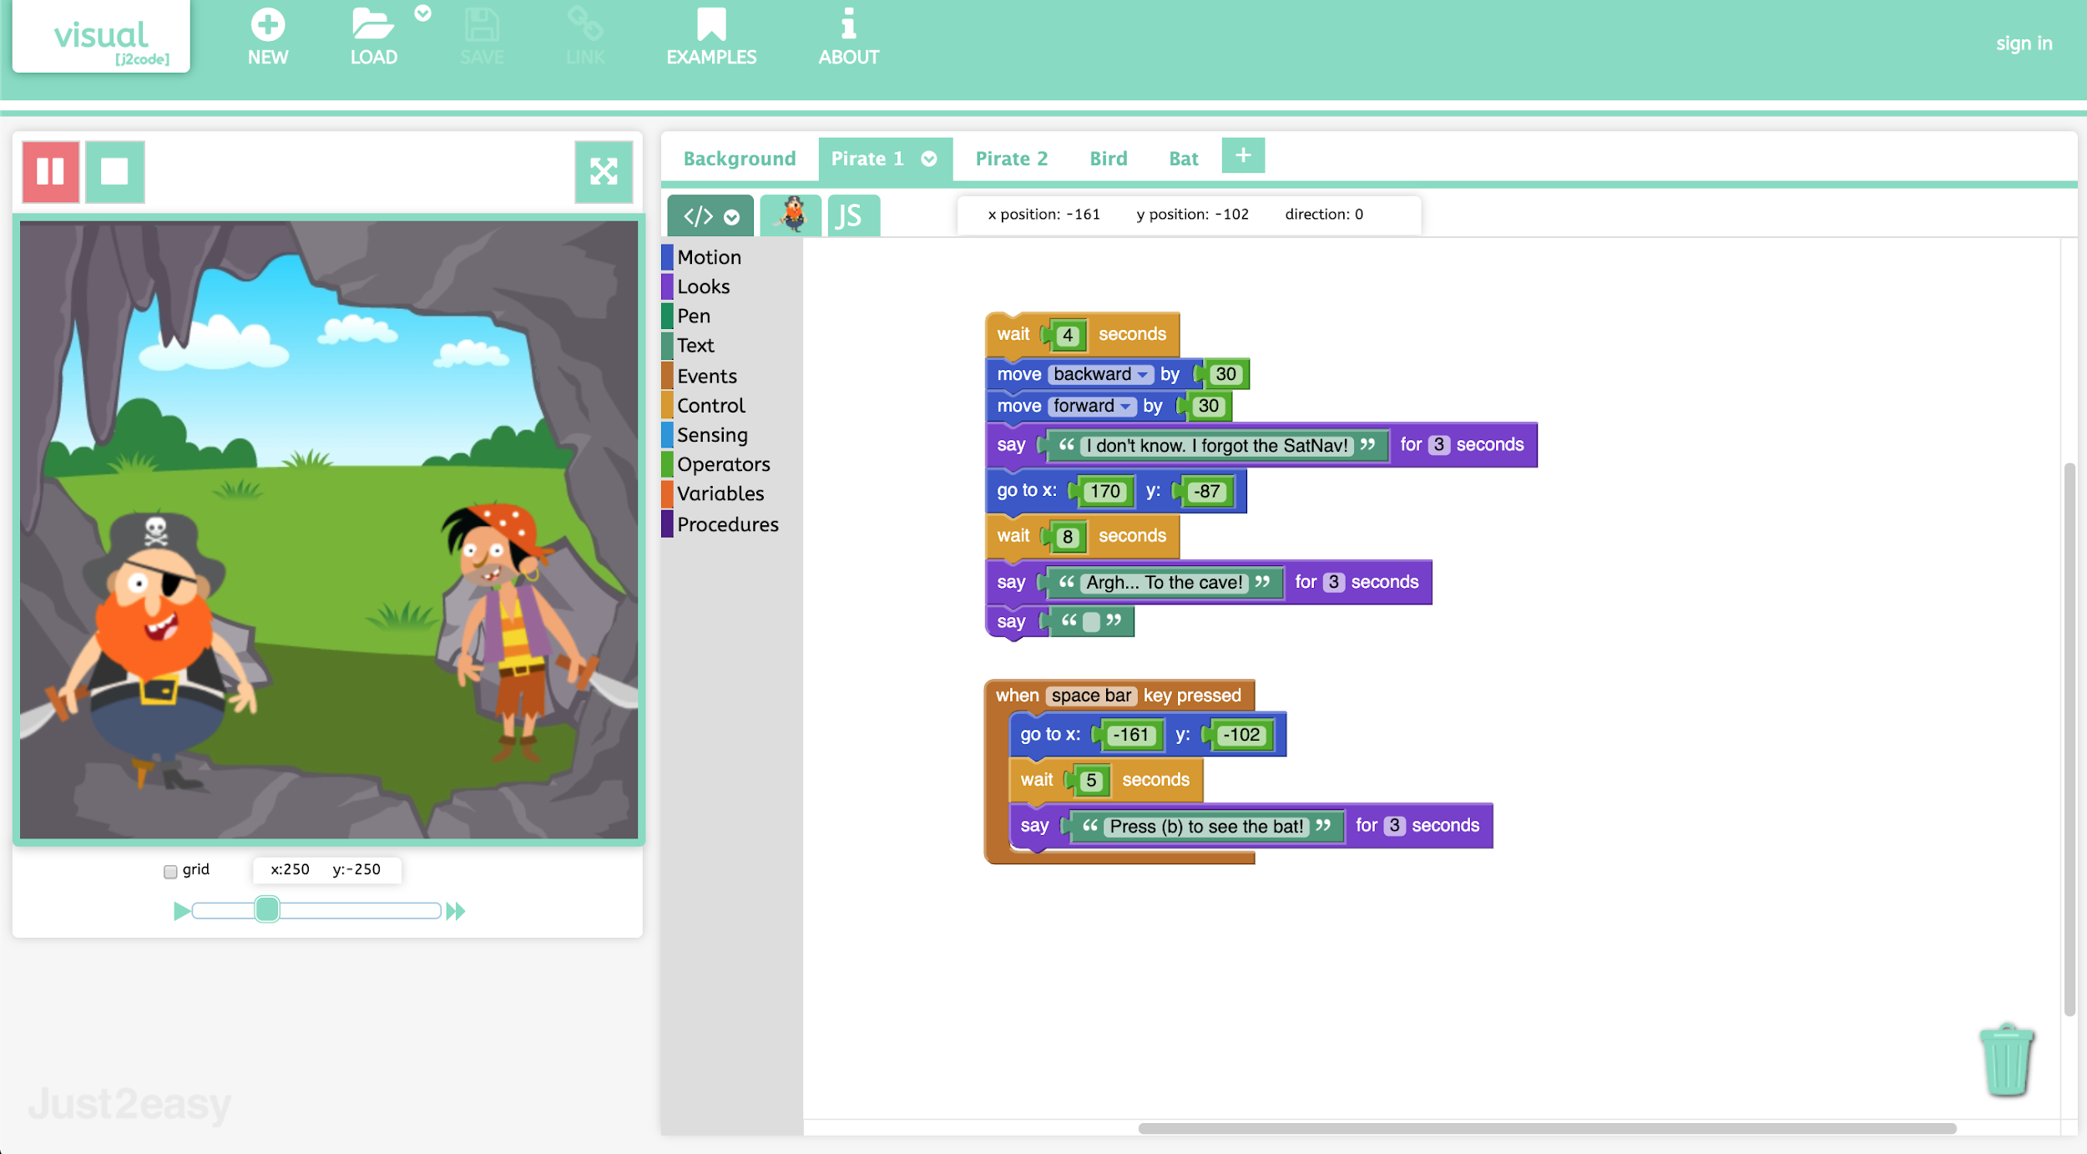
Notes:
Show the example.
Get the children to load the example and look at the code to understand how it works. (Each character is waiting for a certain number of seconds before speaking).
Main Activities
Task 1. Using the template design, write a story for younger children. The children should make the program perform an action using the "when space key pressed" block.
If you are working with tablets, try using "when this sprite clicked" as an alternative. More able children can choose their own background and characters. (The children may need time to plan their ideas, therefore further lesson time may be required).
Task 2. Get the children to add more characters and include them in their story.

Slide 7
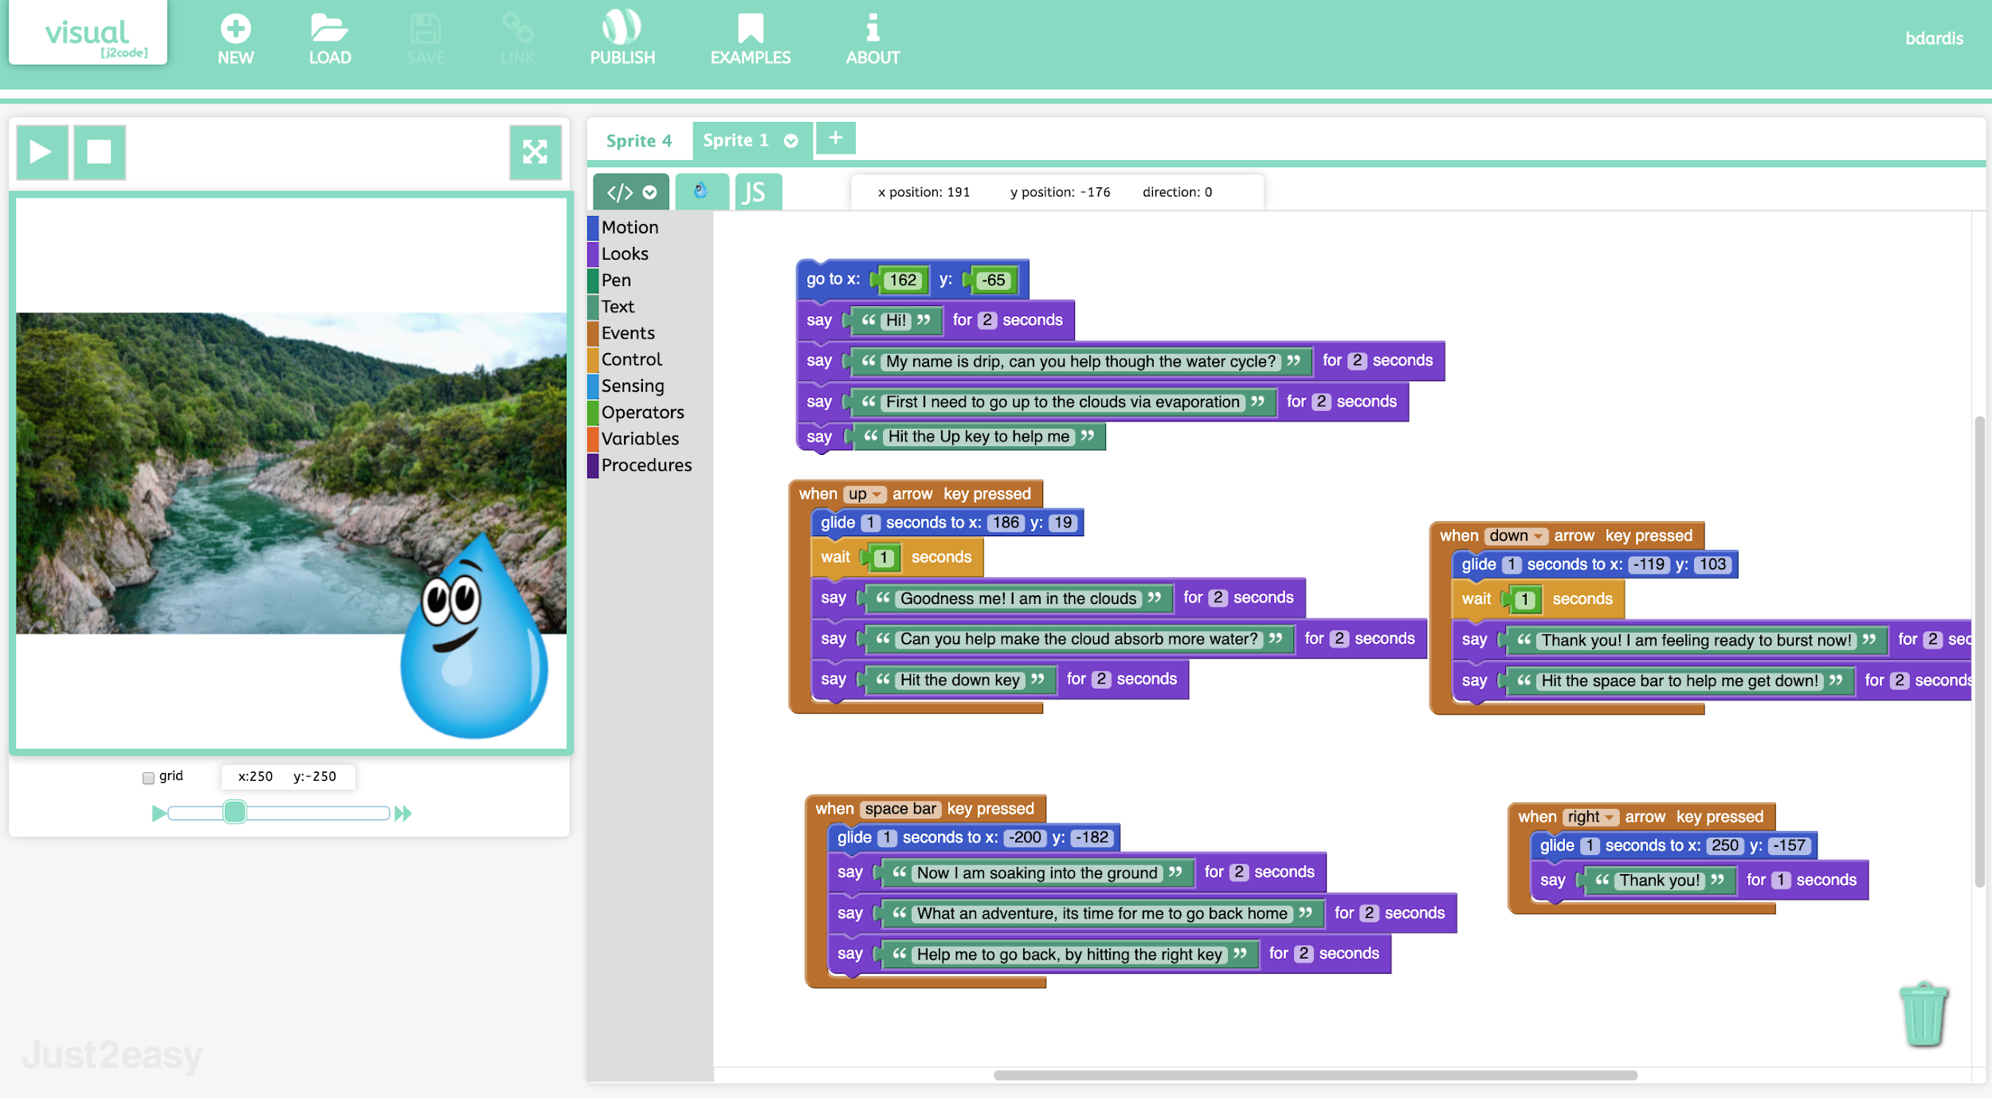
Notes:
Explore and challenge
Challenge
Children add a second background (see example) and get the background to change at an appropriate point in the story.
Children may experiment by making different endings to a story depending on which character is clicked. Share the stories with younger children in the school.
You may want to remix this project into a different story, or to explain a concept here is an example using the water cycle.
https://www.j2e.com/london-grid-for-learning/bdardis/The+water+cycle/

